Slide 1
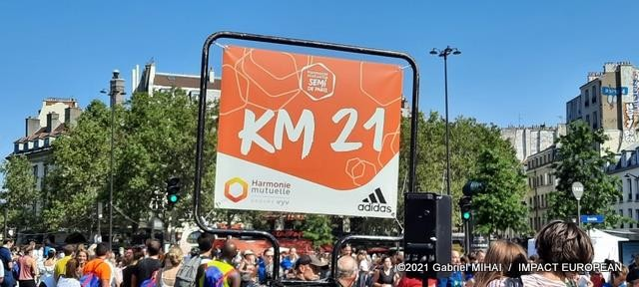
The Paris Half-Marathon is back: the race records have fallen
WITH 25,000 PARTICIPANTS, INSTEAD OF 40,000, AND THE HEALTH PASS
Gabriel MIHAI| Photos and vidéo Gabriel MIHAI | 06/09/2021

Slide 2
After being canceled at the last moment on February 29, 2020, the day before the race, due to the Covid pandemic, the event is back this Sunday, September 5.
With 25,000 participants, instead of 40,000, and the health pass.
However, there is no question of forgetting the sanitary instructions, since a valid sanitary pass will be required from each of the 25,000 runners expected at the start of this 21.0975-kilometer race. Almost half the number of previous editions, where more than 40,000 runners from all over France and around the world gathered in Paris.
But the great novelty of this 28th edition is the new route unveiled to the public. Even if the Harmonie Mutuelle Semi de Paris will take up its quarters in the east of the
capital, this year the start will be given on the Île Saint-Louis (Paris Center) for a planned arrival, rue de Lyon, just after the place de la Bastille (11th).
The Paris half marathon records dating back to 2012 were broken by Kenyans Moses Kibet and Betty Limpus. After an 18-month absence due to the pandemic, the runners had legs.
On the men's side, the event was won by Kenyan Moses Kibet in 59'42 ", breaking the event record of 2", which had been held since 2012 by his compatriot Stanley Biwott. The victory was played by two, against Hillary Kipkoech (59'44 ''). Justus Kangogo (1h01 ') completes the podium. The first Frenchman, Florian Carvalho, took 4th place in 1:01:05.
Moses Kibet covered the distance in 59′42 ′ 'at an incredible speed of 21.21 km / h, which corresponds to a time of 2′49 ′' per kilometer.
Among women, too, the record fell. The Kenyan Betty Lempus arrived at Place de la Bastille 1h 05 ′ 46 ′ 'after her departure. Here too, the previous women's record dated from 2012 and it was held by Pauline Njeri (Kenya) in 1h7′55 ′ '. Lempus beat her compatriot Jackline Chepngeno and the Frenchwoman Mathilde Le Dantec who finished third in 1:14:55 at an average of 16.9km / h.
The Paris marathon will meet on October 17

Slide 3
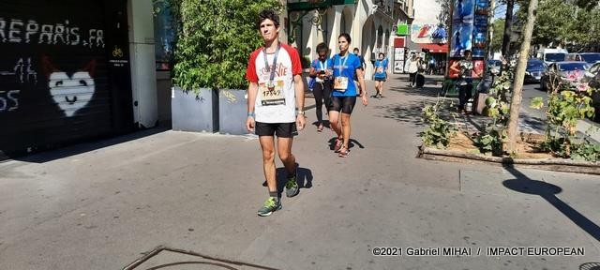
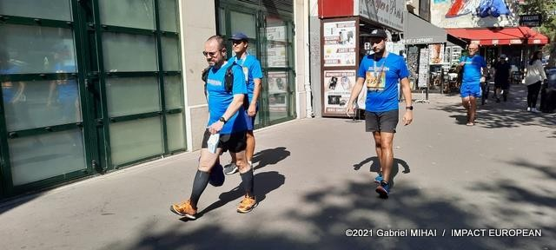
The 25,000 runners will set off from Île Saint-Louis, in the heart of Paris, and arrive at Place de la Bastille, after passing through the François-Mitterrand library, the Bois de Vincennes, Bercy and the town hall. A beautiful program, under a sun that should be quite generous. In a little over a month, on October 17, the marathon will take its place in the streets of Paris. All the bibs have already been allocated, since mid-July.
The return to normality, therefore, for the runners. But not everywhere yet. If in Paris, the tests are maintained, this is not the case for example in Prague. The 2021 edition of the Czech capital marathon, which was scheduled for October 9, has been canceled due to health restrictions caused by the resumption of the coronavirus pandemic.

Slide 4
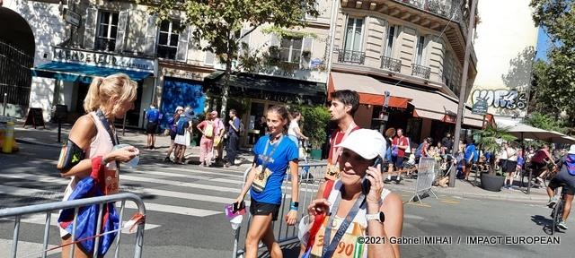

Slide 5
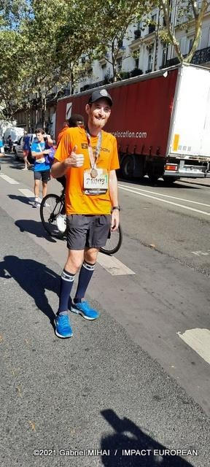

Slide 6
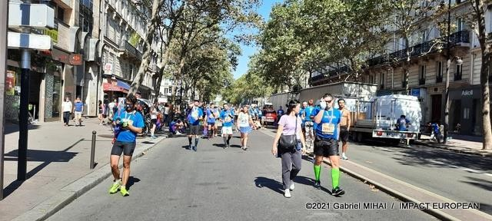

Slide 7
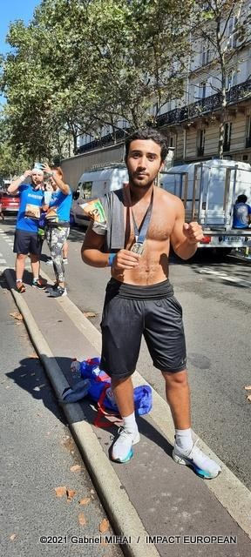

Slide 8
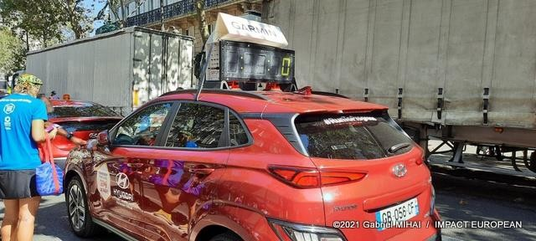

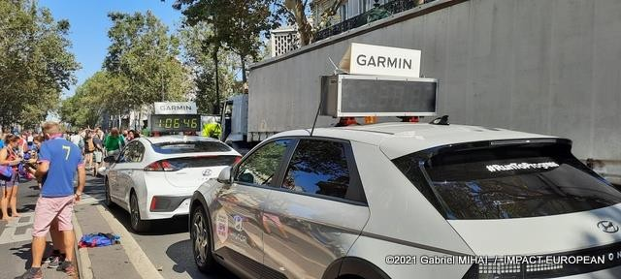

Slide 9
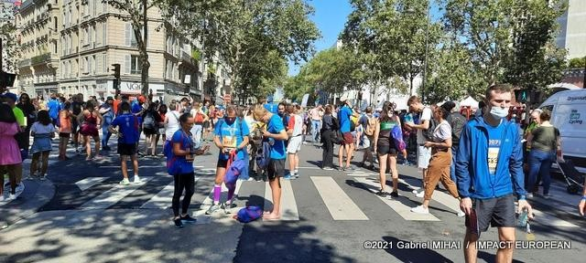
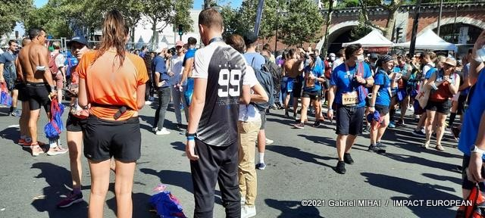
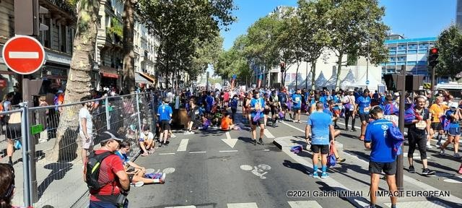

Slide 10
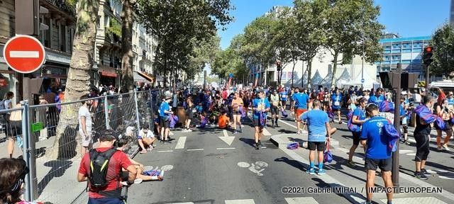
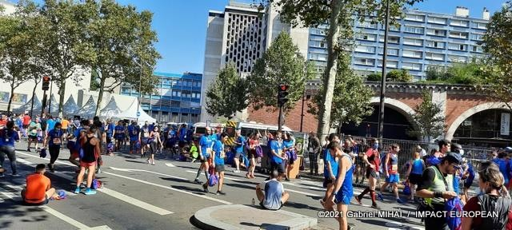
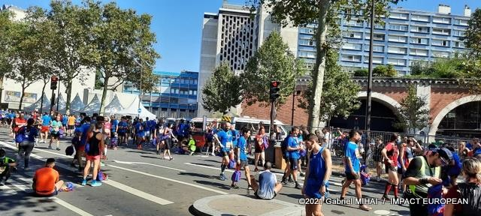

Slide 11
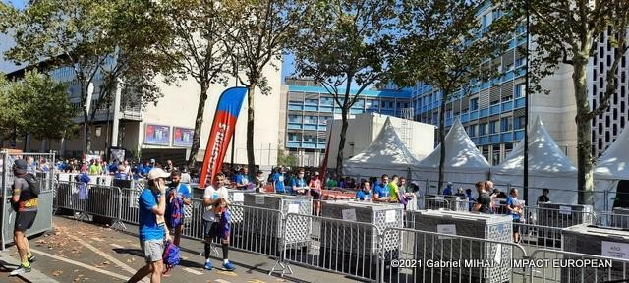
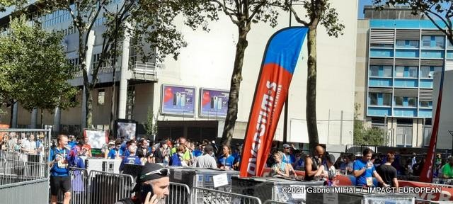
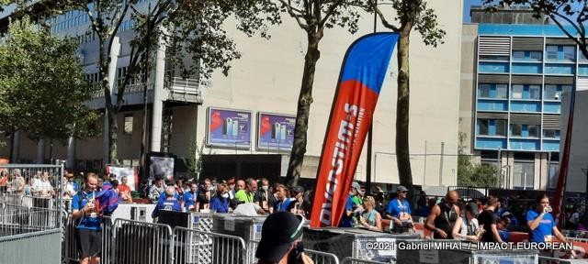

Slide 12
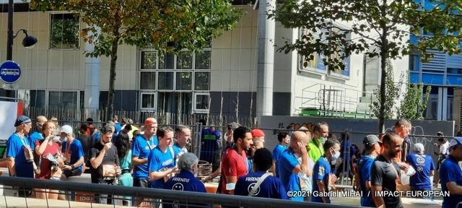
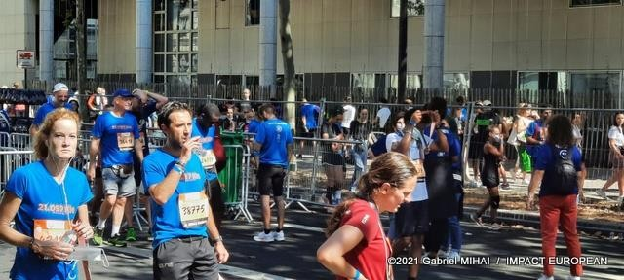
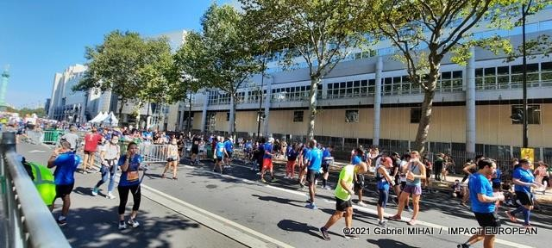

Slide 13
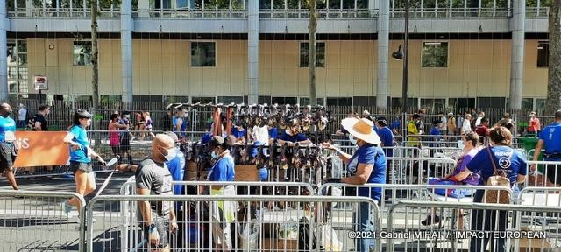
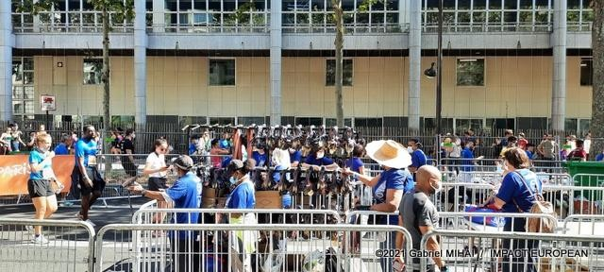


Slide 14
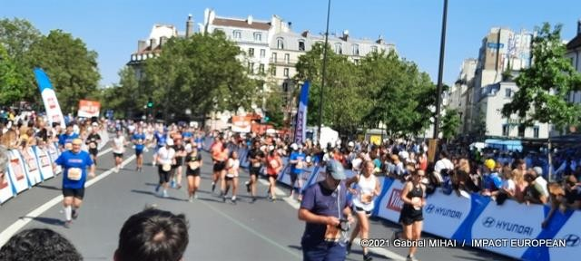
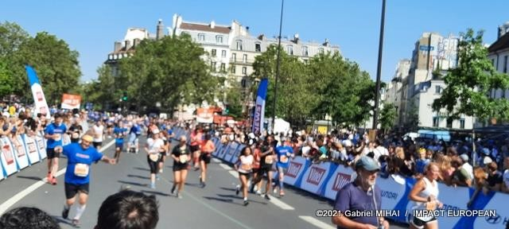
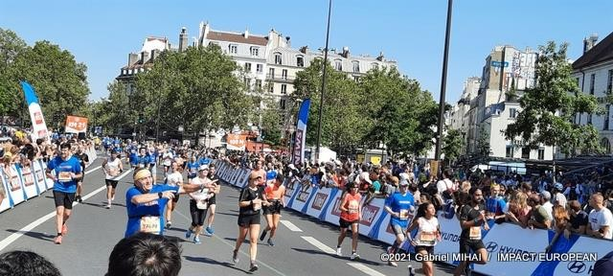

Slide 15
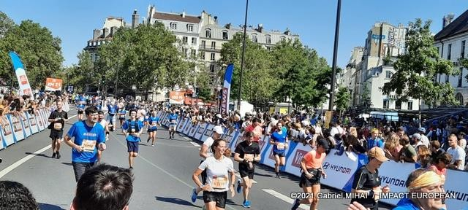
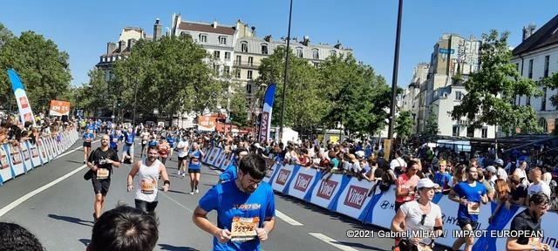
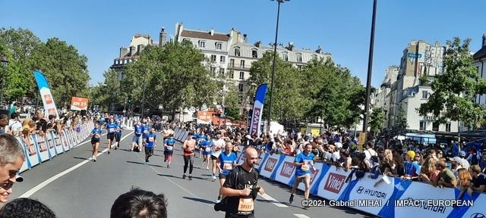

Slide 16
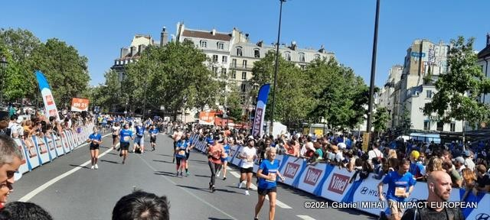

Slide 17
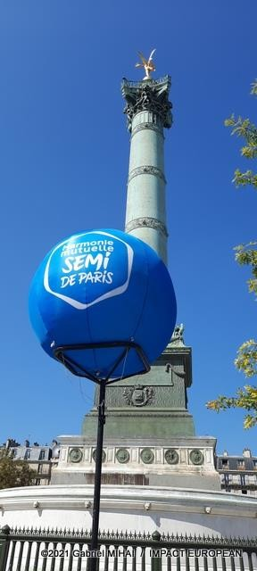

Slide 18
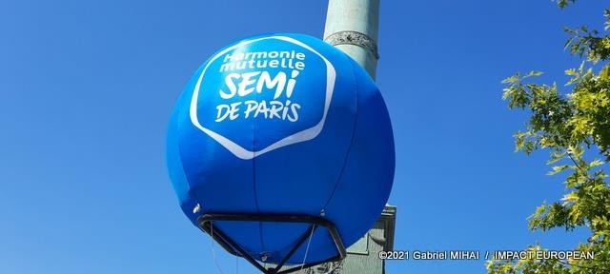
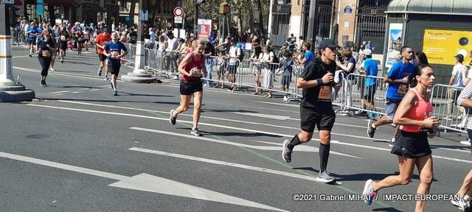
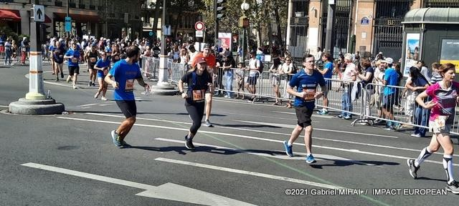

Slide 19
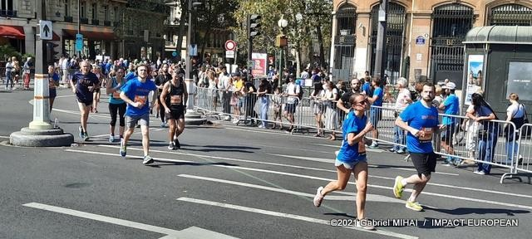
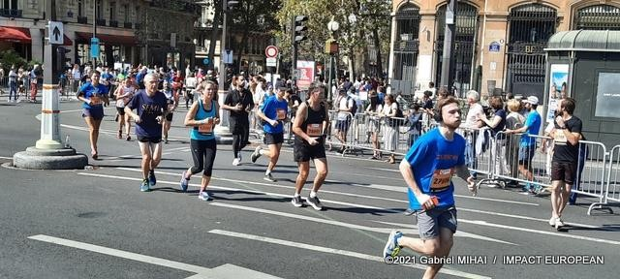
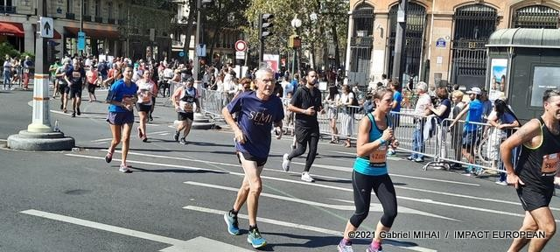

Slide 20
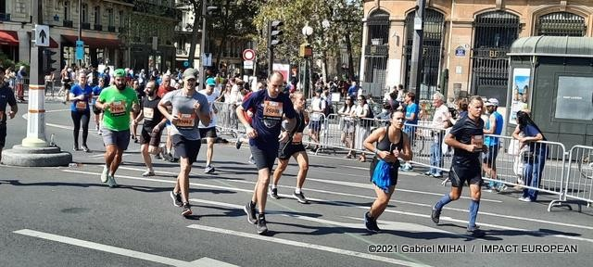
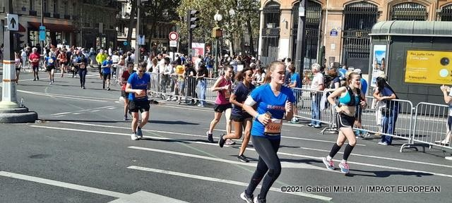
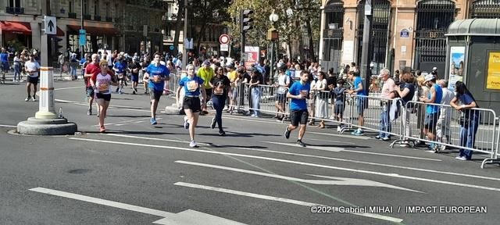

Slide 21
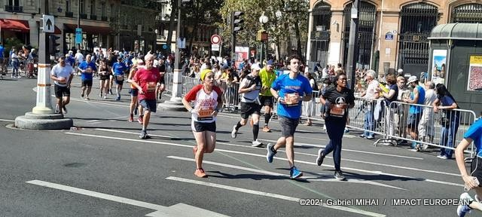
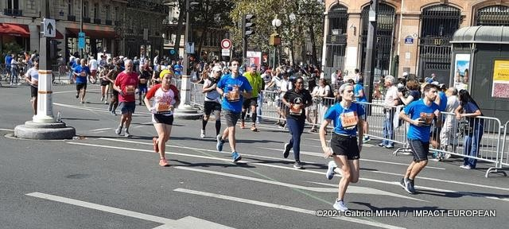
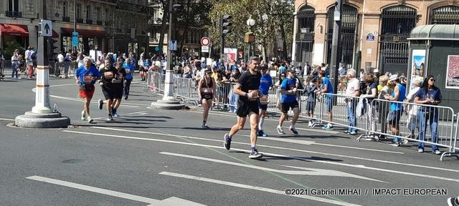

Slide 22
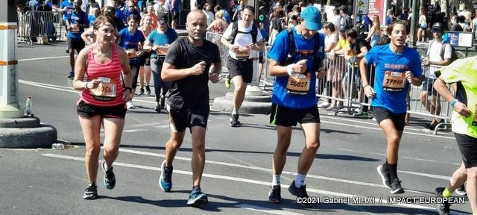
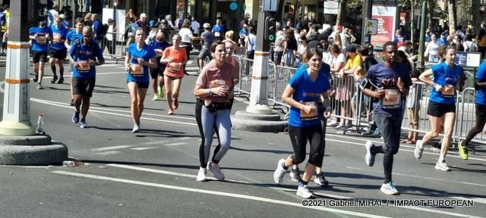
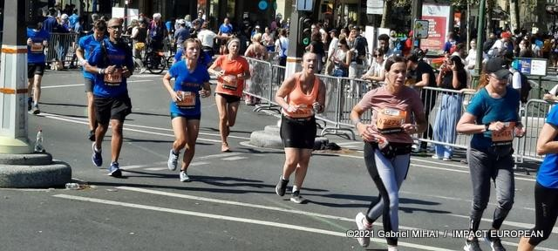

Slide 23
